Slide 1
How to install Windows11
from a USB drive
on your DIY PC
Jerry Xing

Slide 2
overview
Equipment and Preparation
On Your Old PC
On Your New PC

Slide 3
Equipment
and
Preparation

Slide 4
Equipment and Preparation
A USB drive of at least 16GB in size
Old PC (or any PC that can be used)
Internet connection
New PC

Slide 5
Equipment and Preparation
Backup your USB drive (if needed)
Empty your USB drive
Log in Microsoft Office website ①
Buy a Windows 11 licence ②
Check if your new PC supports ③
Links
①https://www.microsoft.com/en-ca ③ https://www.microsoft.com/en-us/windows/get-windows-11
②https://www.microsoft.com/en-ca/d/windows-11-home/dg7gmgf0krt0?rtc=1

Slide 6
On Your Old PC

Slide 7
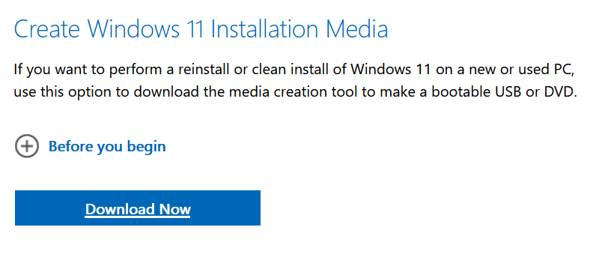
Download Installer
On Your Old PC
Search “Download Windows11” from Microsoft ①
Download Windows11 installer (P1)
Wait for download success
P1
Links
①https://www.microsoft.com/en-US/software-download/windows11

Slide 8
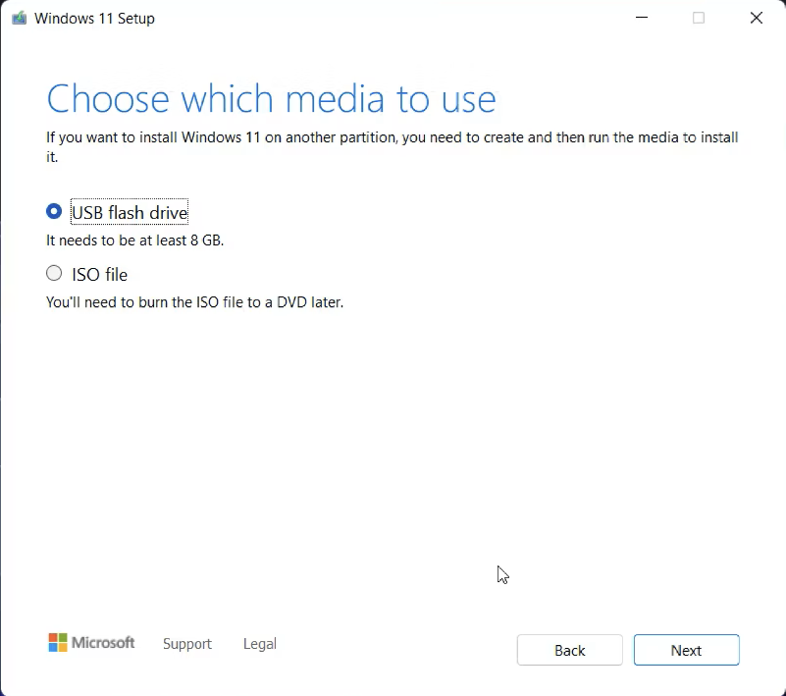
Launch Installer
On Your Old PC
Insert USB drive on Old PC
Choose “USB flash drive” (P2)
Follow instructions
Wait for it
Remove the USB drive
P2

Slide 9
On Your New PC

Slide 10
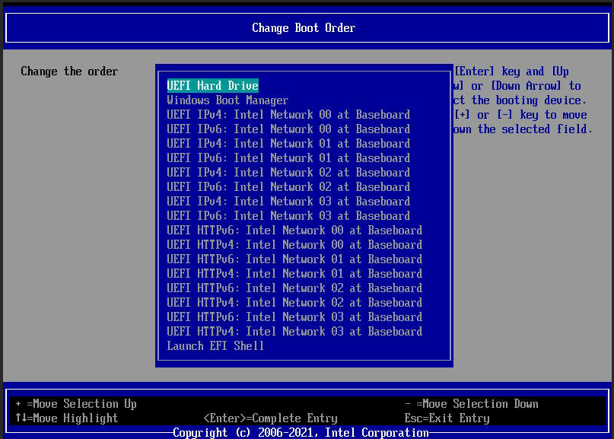
BIOS Setting
On Your New PC
Insert the USB drive
Enter BIOS
“Change Boot Order” (P3)
Save & Exit
P3

Slide 11
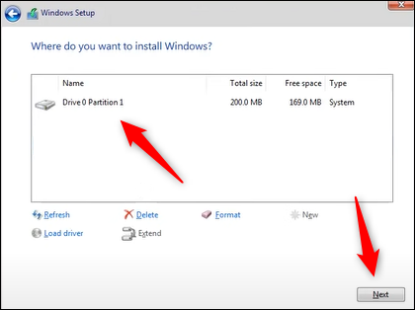
Run the Installer
On Your New PC
Follow instructions
Type in your CDK (or skip)
Select where you want to install Windows (P4)
Wait a minute
Done!
P4

Slide 12
SUMMARY
Adequate preparation
Creating a USB startup drive
Used it on your new PC

